Slide 1
GTFS, Transmodel, NetEX & Siri
Tim Coninx (De Lijn)

Slide 2
GTFS, Transmodel, NetEX & Siri - what is it?
GTFS = General Transit Feed Specification (General <> Google)
De-facto google standard
developers.google.com/transit/
Transmodel = European reference data model
CEN Reference standard
Transmodel (transmodel-cen.eu)
NeTEx & Siri = Network Transport Exchange
CEN Technical standard – XML
NeTEx (netex-cen.eu)
SIRI = CEN norm protocol as real-time addendum on NeTEx

Slide 3
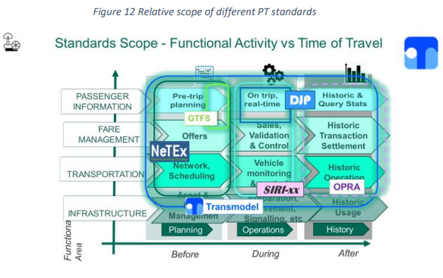
How does it compare?
http://www.transmodel-cen.eu/wp-content/uploads/sites/2/2019/10/StandardsHarmonisation-2019-njsk-v1.0.pdf

Slide 4
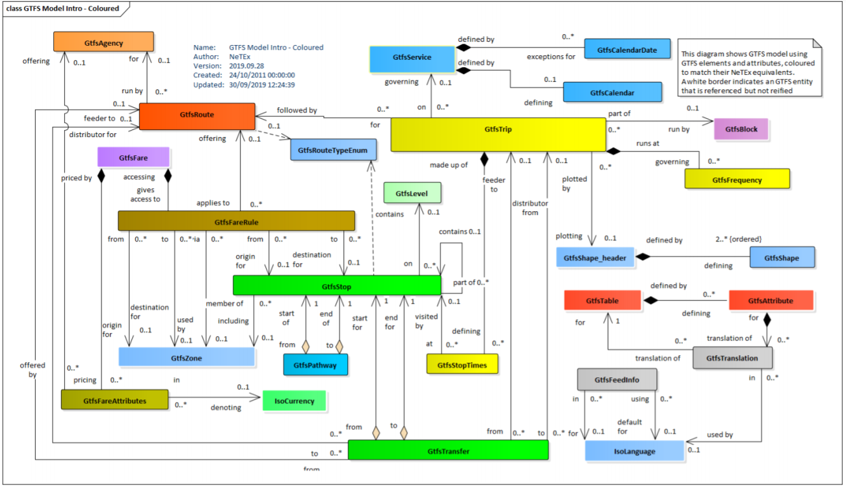
Relation between GTFS and NeTEx

Slide 5
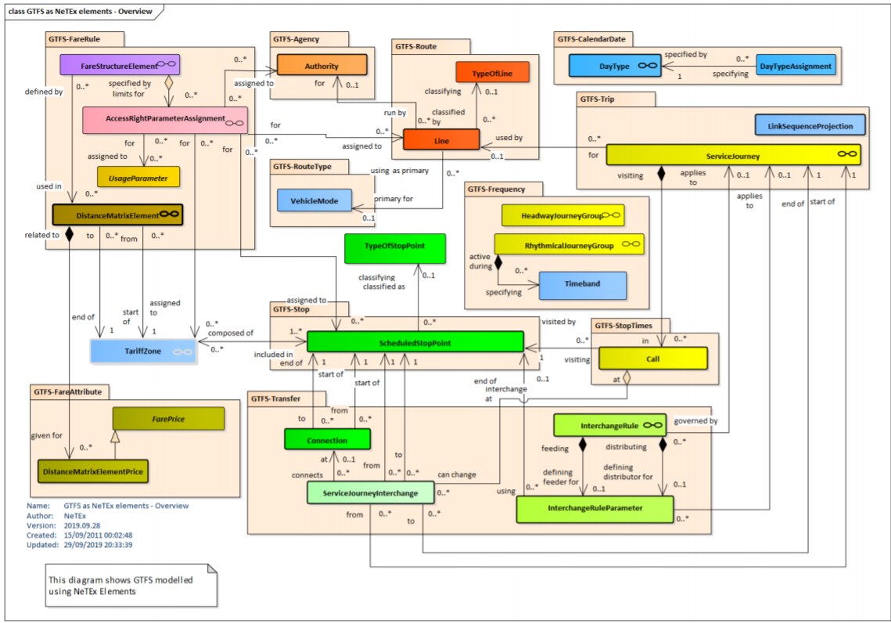
Relation between NeTEx and GTFS

Slide 6
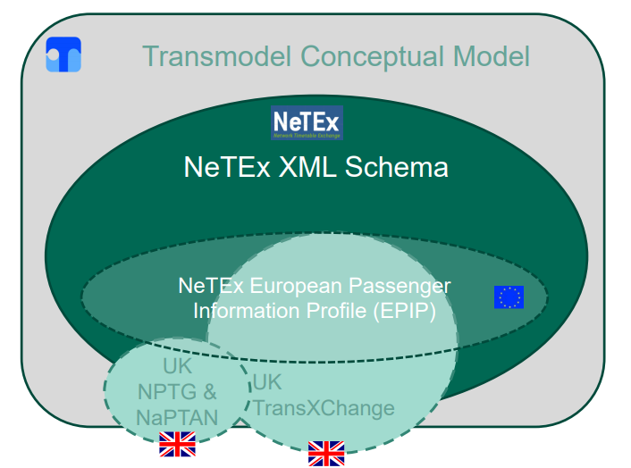
Relation EPIP / NeTEx
http://netex.uk/farexchange/doc/2019.07.16_Workshops/DFT-Workshop2-Routes_and_Timetable-2019.07.16-v02.pdf

Slide 7
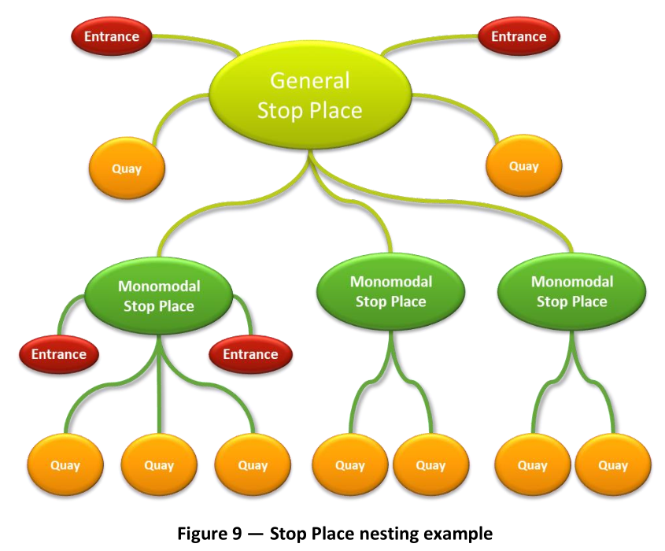
Example “mismatch” EPIP – GTFS

Slide 8











ITS Subactivity 4.5 – Belgium PSA
Onderzoekstraject
GTFS convertors
Onderzoeksopdracht
Scope OSLO Charter
OSLO Traject
Scope Piloot
Implementatie
(vanaf bron)
Implementatie
(conversie GTFS)
Implementatie
(generatie Hastus)
Specificatie

